Slide 1


Rajesh Murari
August 10, 2024

Slide 2

Outline
Executive Summary
Introduction
Methodology
Results
Conclusion
Appendix

Slide 3
Executive Summary
In this capstone project, we will predict if the SpaceX Falcon 9 first stage land successfully using several machine learning classification algorithms.
The steps involved in this project are:
Data Collection, and Data Wrangling
Exploratory Data Analysis
Interactive Data Visualization
Machine Learning Prediction
Summary of all results
Exploratory Data Analysis results show that some features of the rocket launches have a correlation with outcome of launches.
Predictive Analysis Results, shows that Decision Tree is the best machine learning algorithm to predict if the Falcon 9 first stage will land successfully.

Slide 4
Introduction
Project background and context
In this capstone, we will predict if the Falcon 9 first stage will land successfully. SpaceX advertises Falcon 9 rocket launches on its website, with a cost of 62 million dollars; other providers cost upward of 165 million dollars each, much of the savings is because SpaceX can reuse the first stage. Therefore, if we can determine if the first stage will land, we can determine the cost of a launch. This information can be used if an alternate company wants to bid against SpaceX for a rocket launch.
Problems want to find answers
The main question that we are trying to answer is, for a given set of features about a Falcon 9 rocket launch which include its payload mass, orbit type, the location and proximities of a launch site, i.e., the initial position of rocket trajectories, will the first stage of the rocket land successfully?

Slide 5

Section 1

Slide 6
Methodology
The overall methodology includes:
Data collection, wrangling, and formatting using::
SpaceX Rest API
Web Scrapping from Wikipedia
Exploratory Data Analysis (EDA), using:
Numpy and Pandas
SQL
Data Visualization using:
Matplotlib, and Seaborn
Folium
Dash
Machine Learning Prediction using:
Logistic regression
Support Vector Machine (SVM)
Decision Tree
K-nearest Neighbors (KNN)

Slide 7
1. Data Collection, Wrangling, and Formatting
Data collection process involved a combination of API requests from SpaceX REST API (https://api.spacexdata.com/v4/rockets/) and Web Scraping data from a table in SpaceX’s Wikipedia entry (https://en.wikipedia.org/w/index.php?title=List_of_Falcon_9_and_Falcon_Heavy_launches&oldid=1027686922)
Data Columns are obtained by using SpaceX REST API:
FlightNumber, Date, BoosterVersion, PayloadMass, Orbit, LaunchSite, Outcome, Flights, GridFins, Reused, Legs, LangingPads, Block, ReusedCount, Serial, Longitude, Latitude
Data Columns are obtained by using Wikipedia Web Scraping:
Flight No., Launch Site, Payload, PayloadMass, Orbit, Customer, Launch outcome, Version Booser, Booster landing, Date, Time.

Slide 8
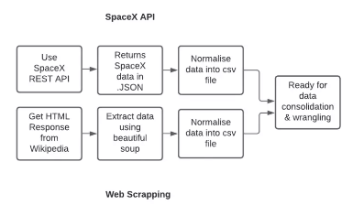
Data Collection and Web Scraping
Data collection with SpaceX REST calls
Data Scraping from Wikipedia
https://github.com/RajeshMurariGitHub/Data-Science-and-Machine-Learning-Capstone-Project/blob/main/jupyter-labs-spacex-data-collection-api.ipynb

Slide 9

Data Wrangling
Data Wrangling:
We perform exploratory data analysis and determined the training labels.
We calculate the number of launches at each site, and the number and occurrences of each orbit.
We created landing outcome label from outcome column and exported the result to csv
The link to note book is:
https://github.com/RajeshMurariGitHub/Data-Science-and-Machine-Learning-Capstone-Project/blob/main/labs-jupyter-spacex-data_wrangling_jupyterlite.jupyterlite.ipynb

Slide 10
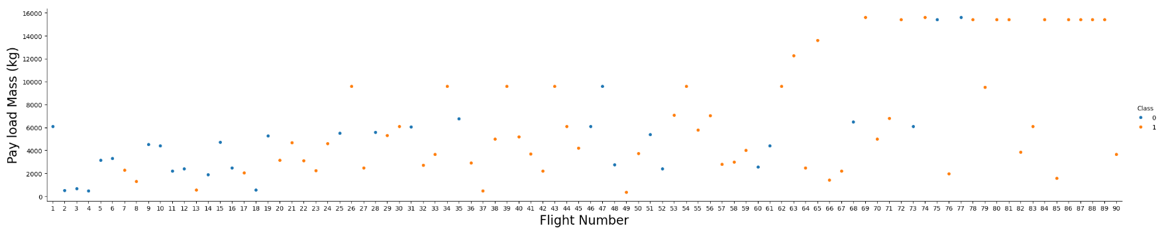
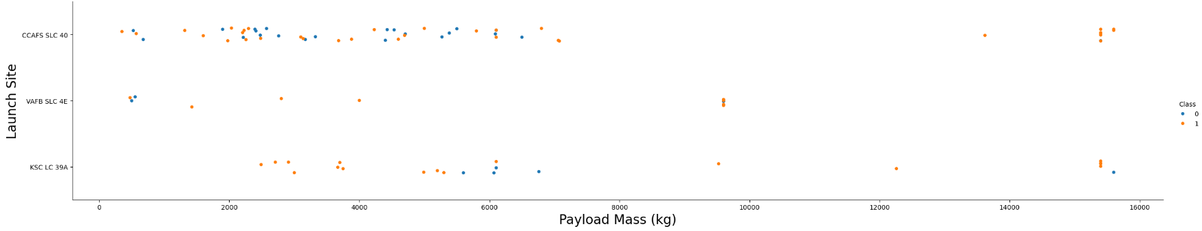
EDA with Data Visualization
Pandas and Numpy:
The number of launches on each launch site
The number of occurrence of each orbit
The number and occurrence of each mission outcome
https://github.com/RajeshMurariGitHub/Data-Science-and-Machine-Learning-Capstone-Project/blob/main/jupyter-labs-eda-dataviz.ipynb.jupyterlite.ipynb

Slide 11
EDA with SQL
SQL queries performed include:
Display the names of the unique launch sites in the space mission
Display 5 records where launch sites with the string ‘KSC’
Display the total payload mass carried by boosters launched by NASA (CRS)
Display average payload mass carried by booster version F9 v1.1
List the date where the successful landing outcome in drone ship was achieved.
List the names of the boosters which have success in ground pad and have payload mass greater than 4000 but less than 6000.
List the total number of successful and failure mission outcomes.
List the names of the booster versions which have carried the maximum payload mass. Use a subquery.
List the records which will display the month names, succesful landing_outcomes in ground pad ,booster versions, launch_site for the months in year 2017.
Rank the count of landing outcomes (such as Failure (drone ship) or Success (ground pad)) between the date 2010-06-04 and 2017-03-20, in descending order
https://github.com/RajeshMurariGitHub/Data-Science-and-Machine-Learning-Capstone-Project/blob/main/jupyter-labs-eda-sql-edx_sqllite.ipynb

Slide 12
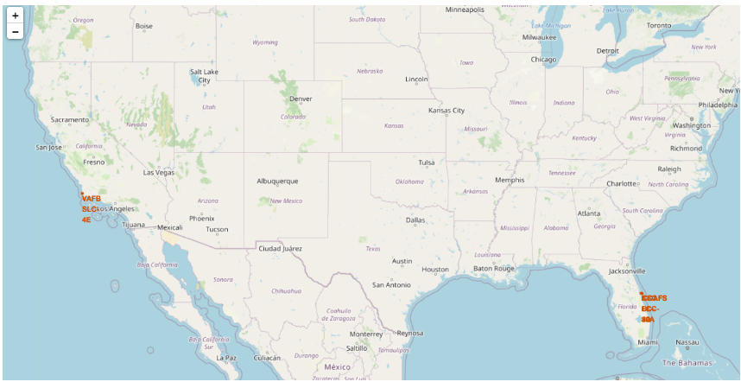
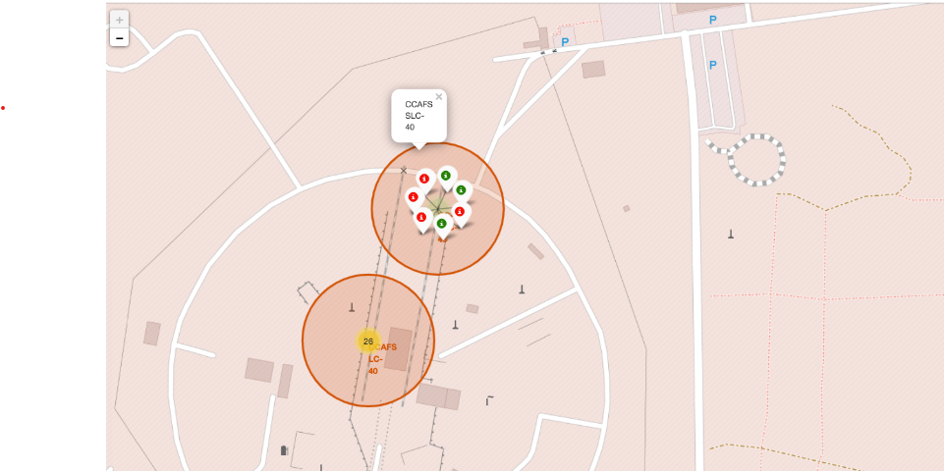
Build an Interactive Map with Folium
All launch sites considered in this project are in very close proximity to the coast While starting rockets towards the ocean we minimize the risk of having any debris dropping or exploding near people.
From the color-labeled markers in marker clusters, you should be able to easily identify which launch sites have relatively high success rates..

Slide 13
Predictive Analysis (Classification)
We loaded the data using numpy and pandas, transformed the data, split our data into training and testing.
We built different machine learning models and tune different hyperparameters using GridSearchCV.
We used accuracy as the metric for our model, improved the model using feature engineering and algorithm tuning.
We found the best performing classification model.
The link to the notebook is https://github.com/RajeshMurariGitHub/Data-Science-and-Machine-Learning-Capstone-Project/blob/main/SpaceX_Machine_Learning_Prediction_Part_5.jupyterlite.ipynb

Slide 14
Results
Exploratory data analysis results
Interactive analytics demo in screenshots
Predictive analysis results

Slide 15

Section 2

Slide 16

Flight Number vs. Launch Site
From the plot, we found that the larger the flight amount at a launch site, the greater the success rate at a launch site.

Slide 17

Payload vs. Launch Site
The greater the payload mass for launch site CCAFS SLC 40 the higher the success rate for the rocket.

Slide 18
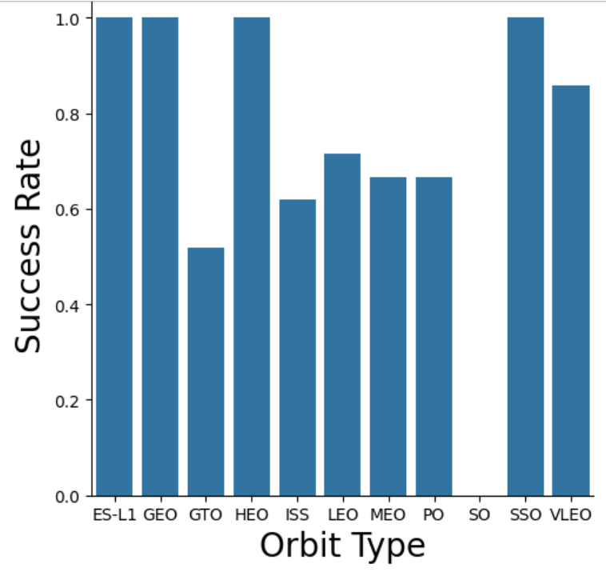
Success Rate vs. Orbit Type
From the Plot, we can see that ES-L1, GEO, HEO, SSO, VLEO had the most success rate.

Slide 19

Flight Number vs. Orbit Type
The plot below shows the Flight Number vs. Orbit type. We observe that in the LEO orbit, success is related to the number of flights whereas in the GTO orbit, there is no relationship between flight number and the orbit.

Slide 20

Payload vs. Orbit Type
We can observe that with heavy payloads, the successful landing are more for PO, LEO and ISS orbits.

Slide 21

Launch Success Yearly Trend
From the plot, we can observe that success rate since 2013 kept on increasing till 2020.

Slide 22
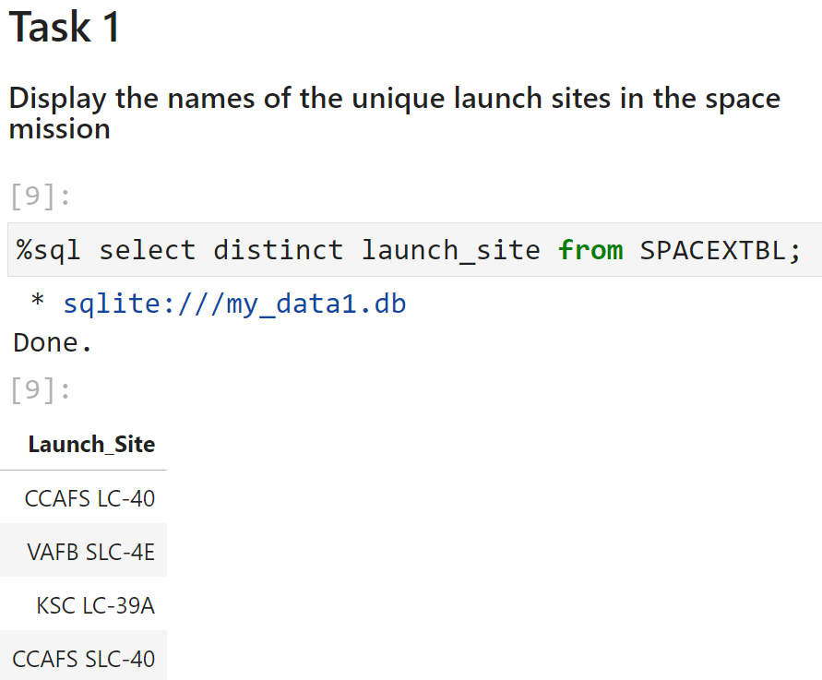
All Launch Site Names
We used the key word DISTINCT to show only unique launch sites from the SpaceX data.

Slide 23
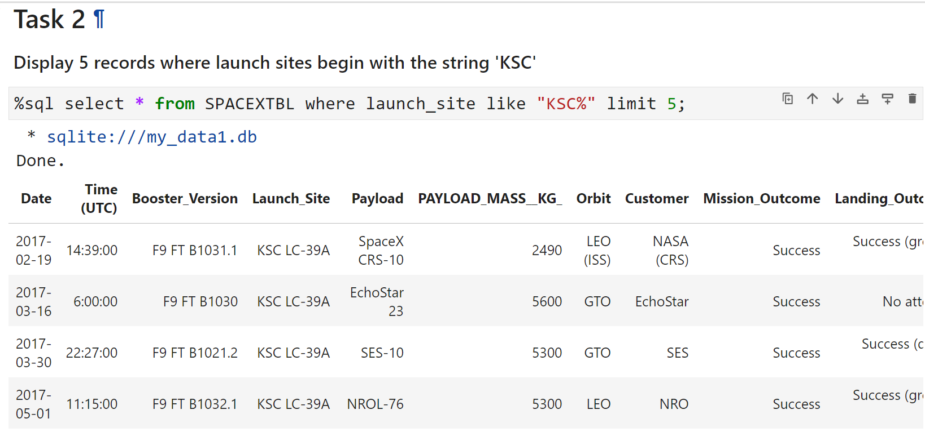
Launch Site Names Begin with 'KSC'
5 records where launch sites’ names start with `KSC`

Slide 24
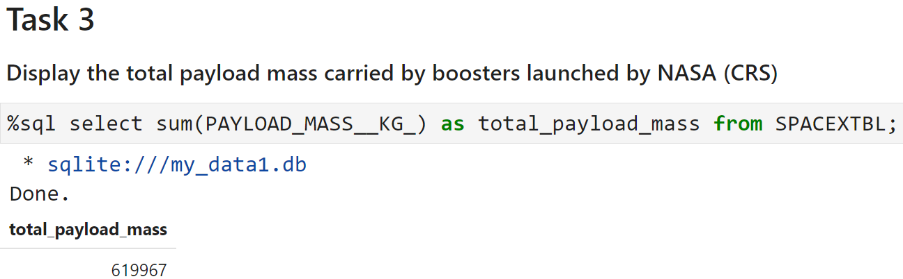
Total Payload Mass
The total payload carried by boosters from NASA

Slide 25
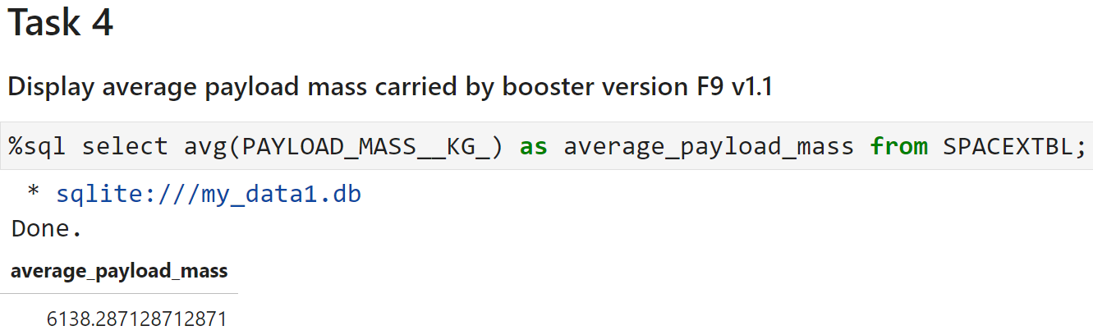
Average Payload Mass by F9 v1.1
The average payload mass carried by booster version F9 v1.1

Slide 26
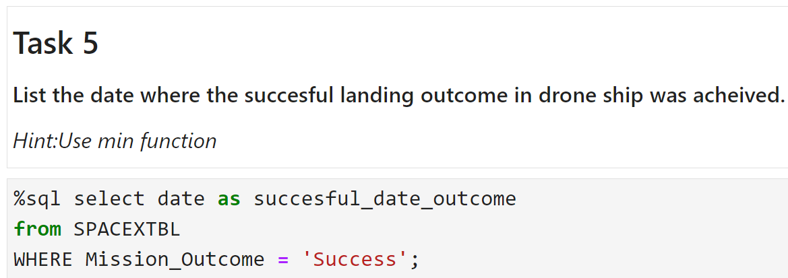
First Successful Ground Landing Date
We observed that the dates of the first successful landing outcome on ground pad was 22nd December 2015

Slide 27
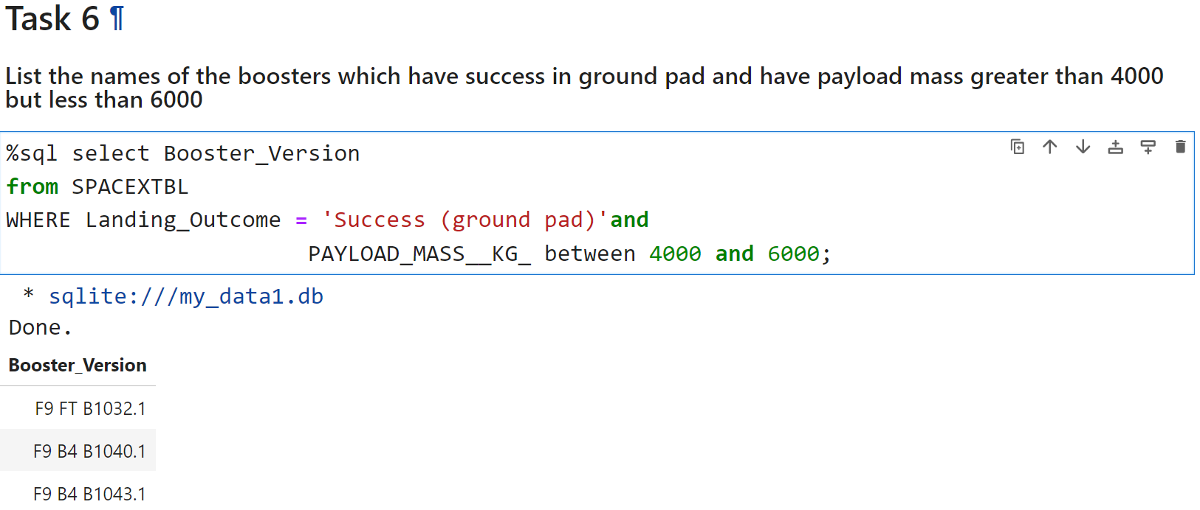
Successful Drone Ship Landing with Payload between 4000 and 6000
We used the WHERE clause to filter for boosters which have successfully landed on drone ship and applied the AND condition to determine successful landing with payload mass greater than 4000 but less than 6000

Slide 28
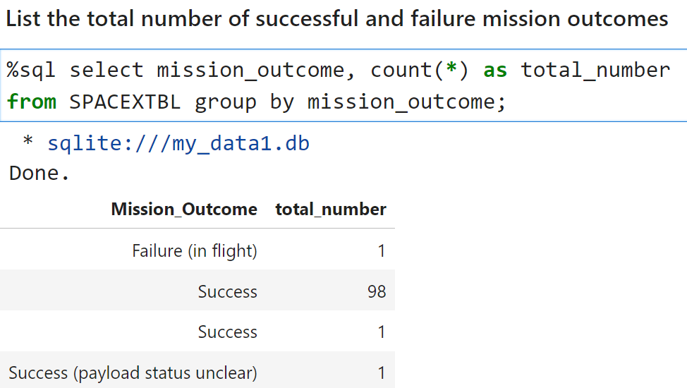
Total Number of Successful and Failure Mission Outcomes
We used wildcard like ‘%’ to filter for WHERE MissionOutcome was a success or a failure.

Slide 29
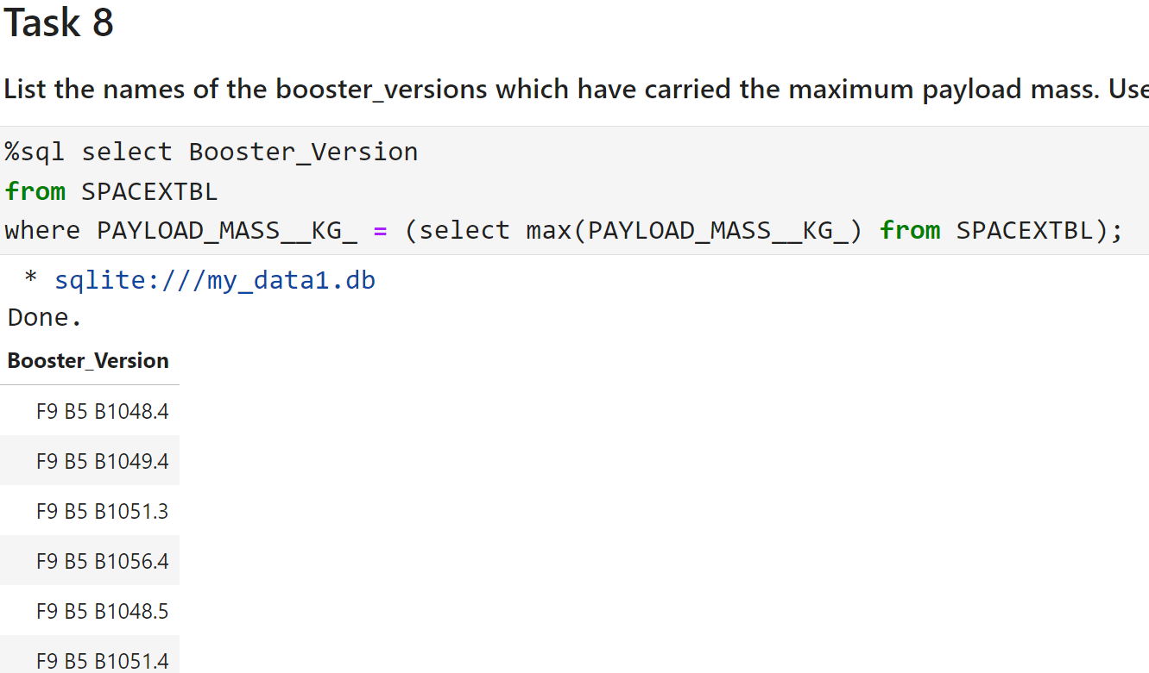
Boosters Carried Maximum Payload
We determined the booster that have carried the maximum payload using a subquery in the WHERE clause and the MAX() function.

Slide 30
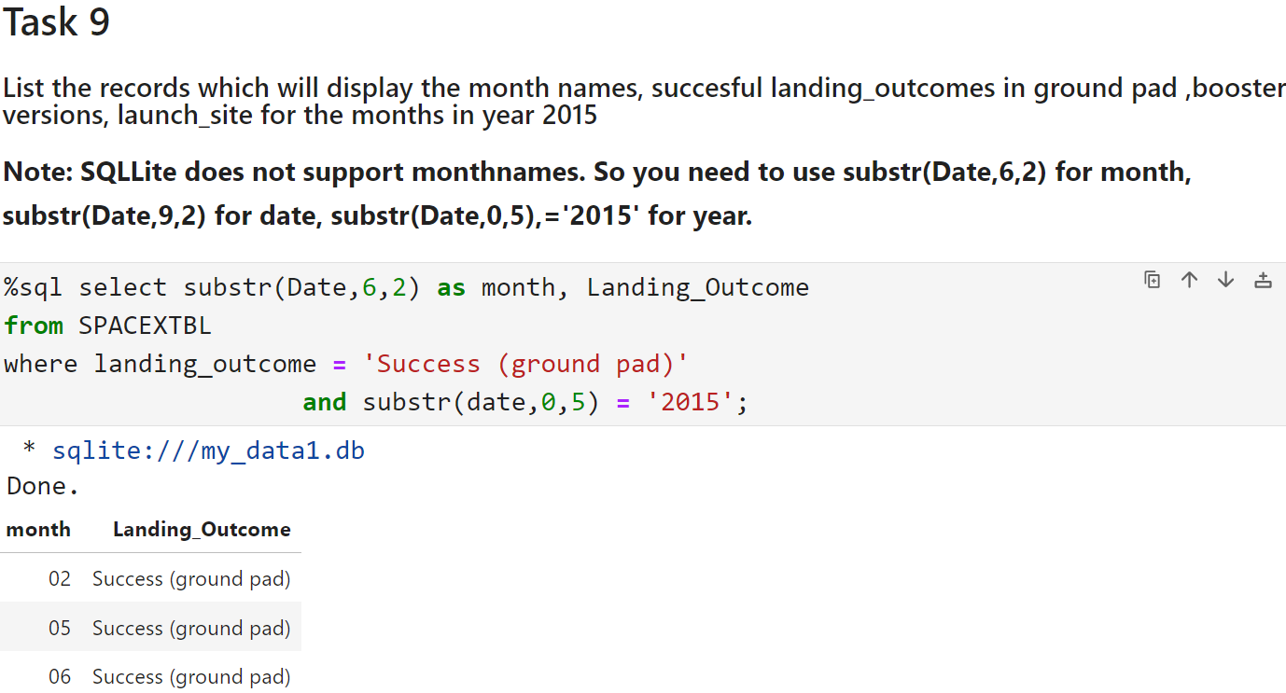
2015 Launch Records
We used a combinations of the WHERE clause, LIKE, AND, and BETWEEN conditions to filter for failed landing outcomes in drone ship, their booster versions, and launch site names for year 2015

Slide 31
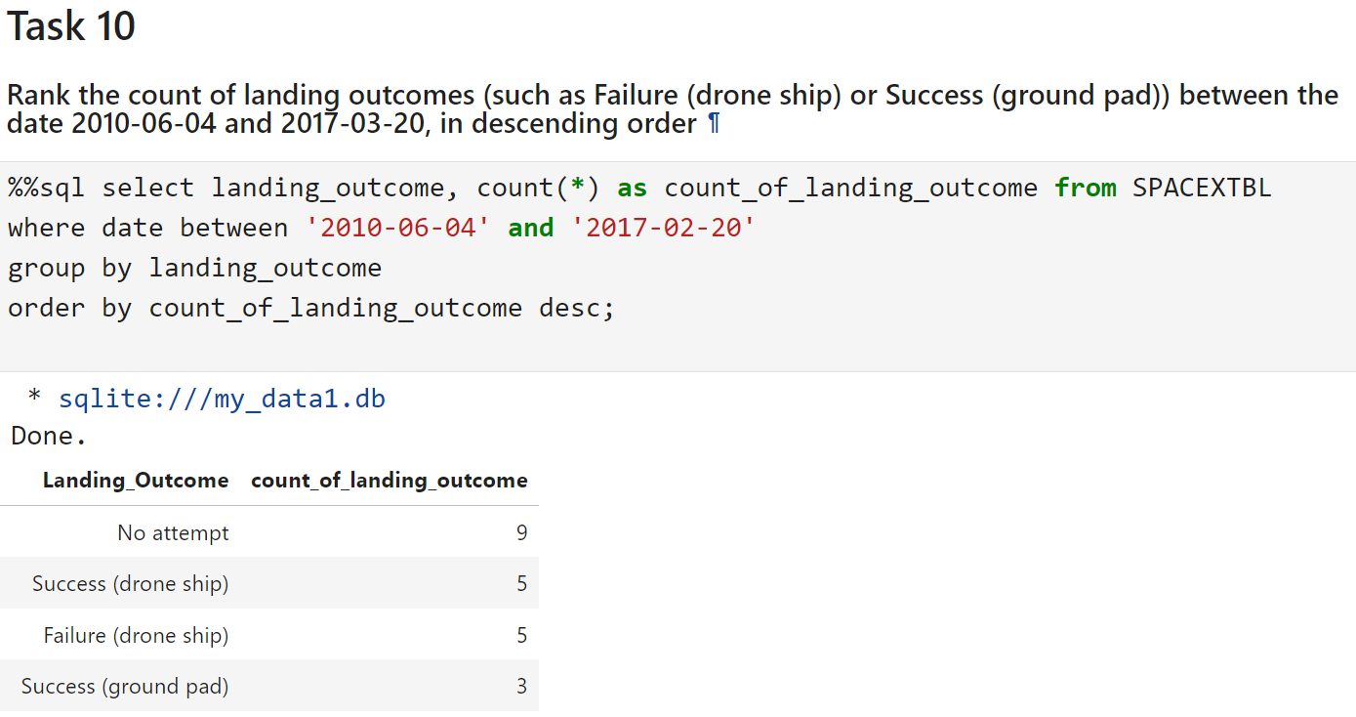
Rank Landing Outcomes Between 2010-06-04 and 2017-03-20
We selected Landing outcomes and the COUNT of landing outcomes from the data and used the WHERE clause to filter for landing outcomes BETWEEN 2010-06-04 to 2010-03-20.
We applied the GROUP BY clause to group the landing outcomes and the ORDER BY clause to order the grouped landing outcome in descending order.

Slide 32

Section 3

Slide 33

All launch sites global map markers

Slide 34

Markers showing launch sites with color labels

Slide 35

Section 4

Slide 36

Pie chart showing the success percentage achieved by each launch site

Slide 37

Pie chart showing the Launch site with the highest launch success ratio

Slide 38

Scatter plot of Payload vs Launch Outcome for all sites, with different payload selected in the range slider

Slide 39

Section 5

Slide 40

Confusion Matrix
The confusion matrix for the decision tree classifier shows that the classifier can distinguish between the different classes. The major problem is the false positives .i.e., unsuccessful landing marked as successful landing by the classifier.

Slide 41
Conclusions
We can conclude that:
The larger the flight amount at a launch site, the greater the success rate at a launch site.
Launch success rate started to increase in 2013 till 2020.
Orbits ES-L1, GEO, HEO, SSO, VLEO had the most success rate.
KSC LC-39A had the most successful launches of any sites.
The Decision tree classifier is the best machine learning algorithm for this task.

Slide 42


